Slide 1

Micro-focus Adjustment

Slide 2
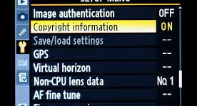
EXIF Data

Slide 3
Background
What is it?
Almost all digital cameras save image files with EXIF (Exchangeable Image File) data. Camera settings and scene information are recorded by the camera into the image file. Examples of stored information are shutter speed, date and time a photo was taken, focal length, exposure compensation, metering pattern and if a flash was used
Photographers can add information to the EXIF data through the SETUP menu

Slide 4
Available on ALL Cameras?
Most (NEWER) DSLR and some Mirrorless cameras automatically record EXIF data
NIKON: D4, D3X, D3S, D3, D810, D800, D700, D610, D600
CANON: 1DX, 1DE, 1D4 1DsMk3, 5D2, 5D3, 50D, 7D
PENTAX: K20
SONY: A900
Others may support it, check your manual
NOTE: Not all cameras let you add information (copyright or artist)

Slide 5
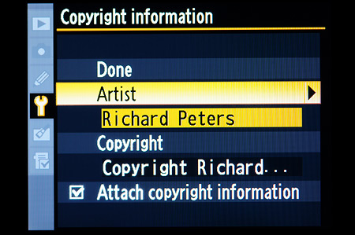

What does it look like
Canon 7D
Nikon D600

Slide 6
What can you do with it?
Most photo editing tools allow you to view/edit EXIF data
EXIF viewers / editors are available on-line (software not required)
Jeffrey’s EXIF Viewer http://regex.info/exif.cgi
VerEXIF http://www.verexif.com/en/
EXIFData.com http://exifdata.com

Slide 7
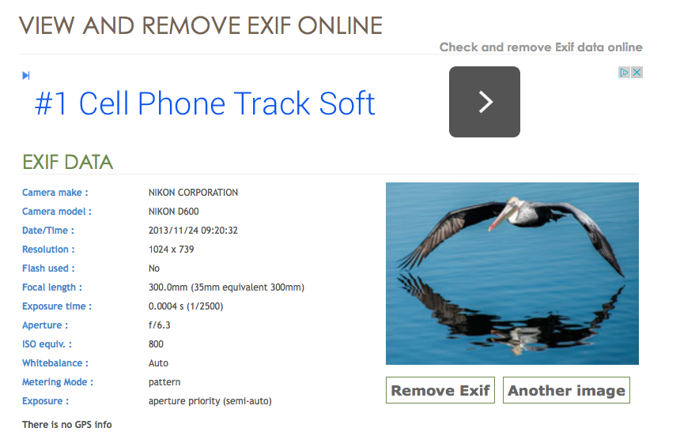
VerEXIF Example

Slide 8
Wrapping It Up
Study the EXIF data of images you like or want to learn from to see how the photographer did it
Set your information following your Users Manual
Check your photo editing software to VIEW, EDIT, or REMOVE EXIF data
Take advantage of on-line tools

